Slide 1
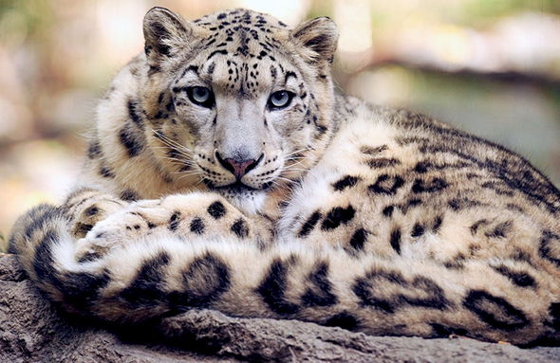
The Snow Leopard
1- Presentation of snow leopard
2- Why it is endangered species
3- Today population
4- Interesting facts

Slide 2
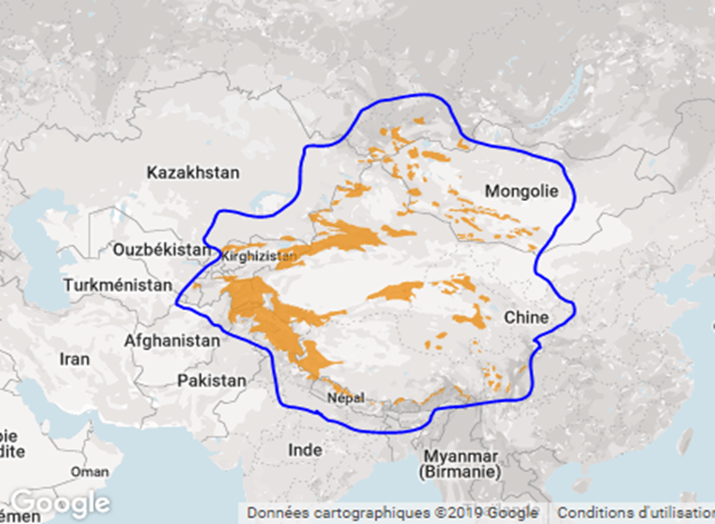
Presentation of the Snow leopard
The Snow leopard lives in Népal.
He’s a carnivore.
His size 1 at 1,5 meter.
He can weight 32 kilos.

Slide 3
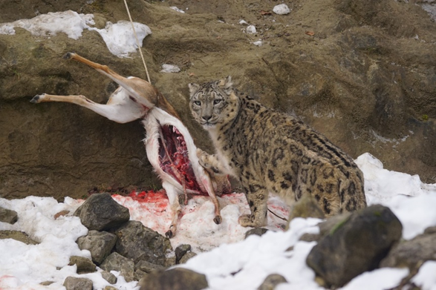
Why is endengered species
The snow leopard is endengered because he’s kill a ship and farmer kill them.

Slide 4
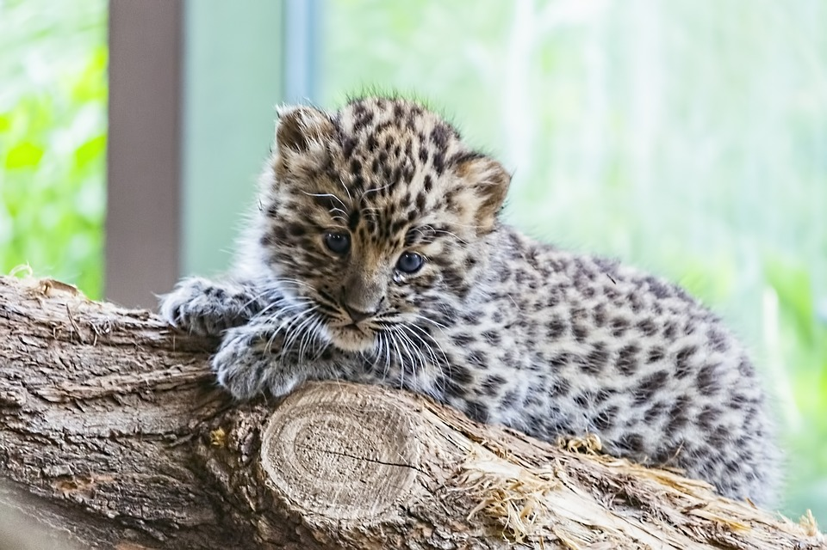
Today estimed the population
the population of snow leopard estimed at 6590 in 2018.

Slide 5
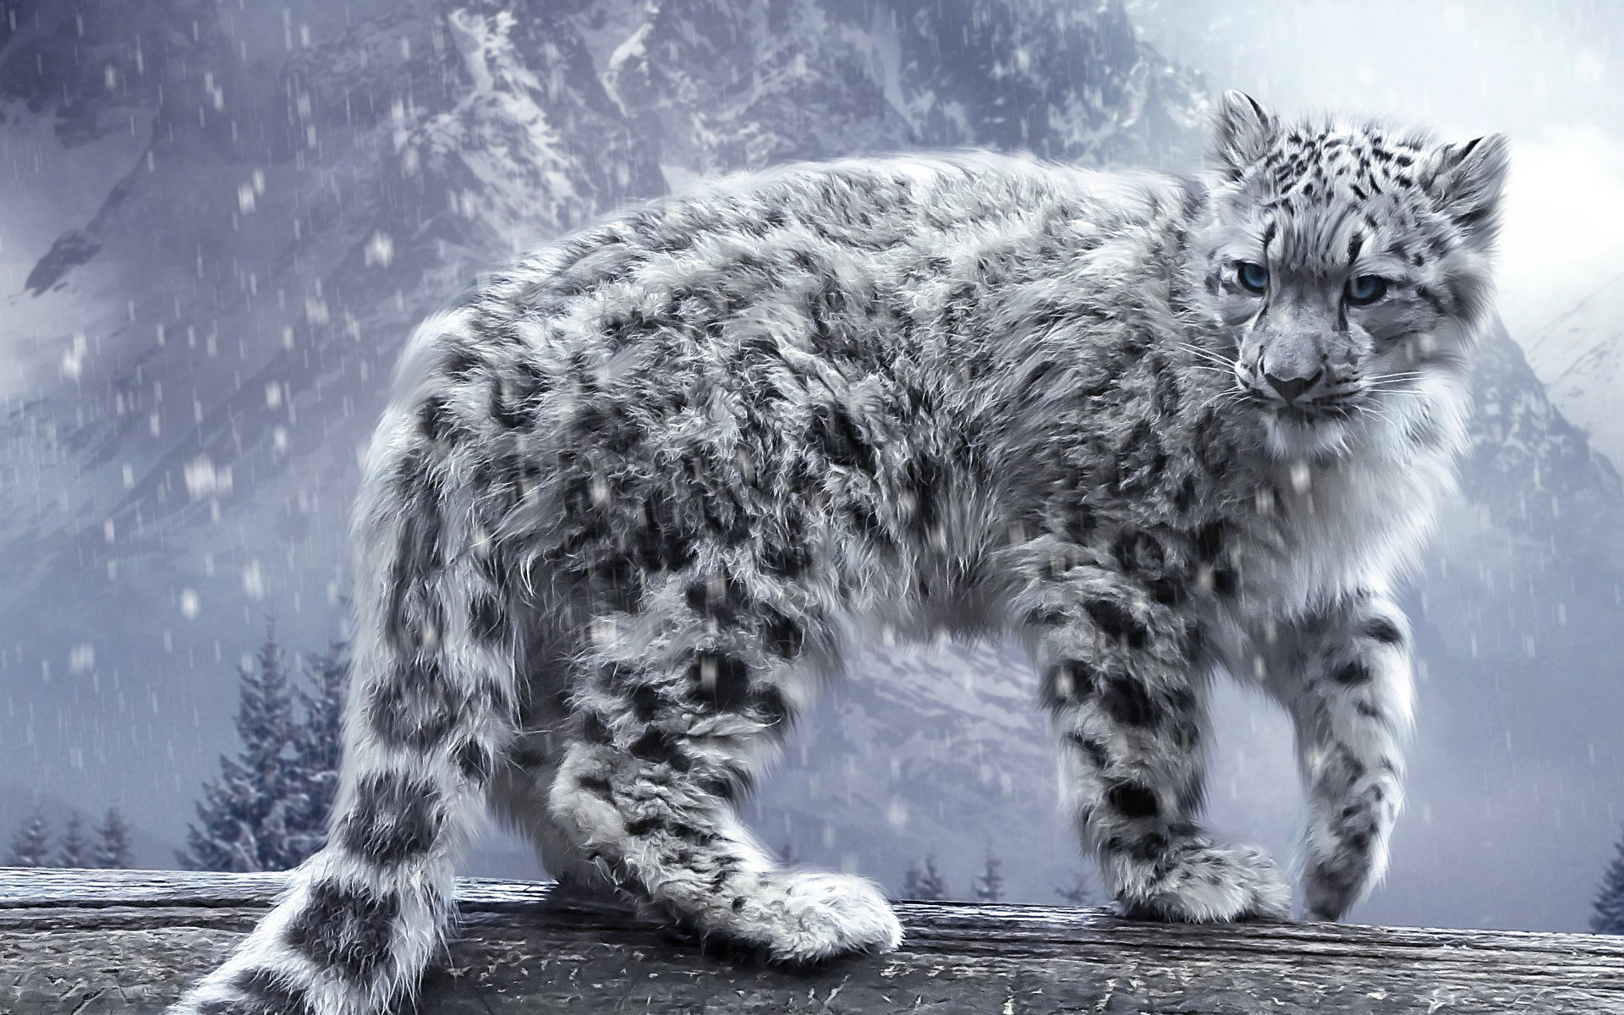
interesting facts of Snow Leopard
The Snow Leopard is individual species. Snow Leopards are one of the most beautiful and mystical wild cats.

