Slide 1
What colour is it?

Slide 2
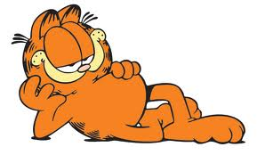
What colour is Garfield?

Slide 3
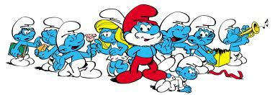
What colour are the smurfs?

Slide 4
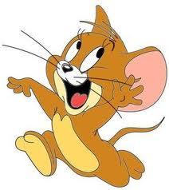
What colour is Jerry?

Slide 5
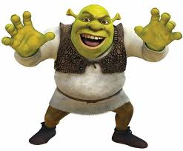
What colour is Shrek?

Slide 6
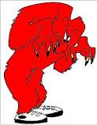
What colour is Gossamer?

Slide 7
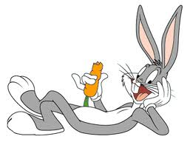
What colour is Bugs Bunny?

Slide 8
What colour is Kitty?

Slide 9
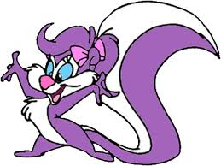
What colour is Fifi La Fume?

Slide 10
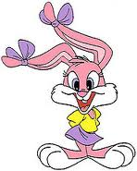
What colour is Babs Bunny?

Slide 11
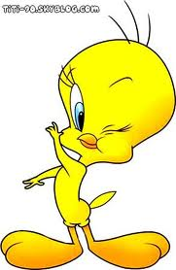
What colour is Titi?

Slide 12
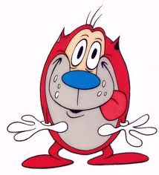
What colour is Stimpy?

Slide 13
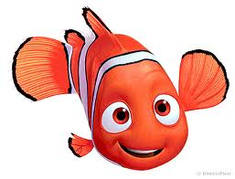
What colour is Nemo?

Slide 14
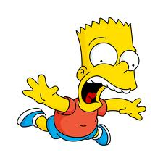
What colour is Bart Simpson?

Slide 15
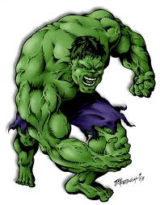
What colour is The Incredible Hulk?

Slide 16
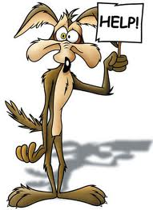
What colour is Wild E. Coyote?

Slide 17
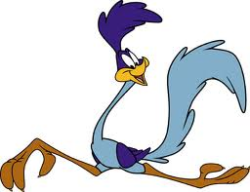
What colour is The Road Runner?

Slide 18
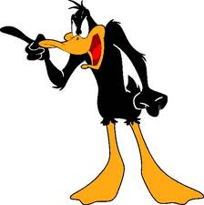
What colour is Daffy Duck?

Slide 19
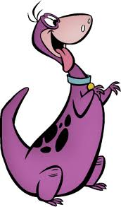
What colour is Dino?

Slide 20
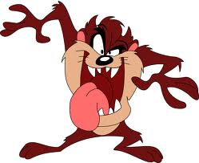
What colour is Taz?

