Slide 1
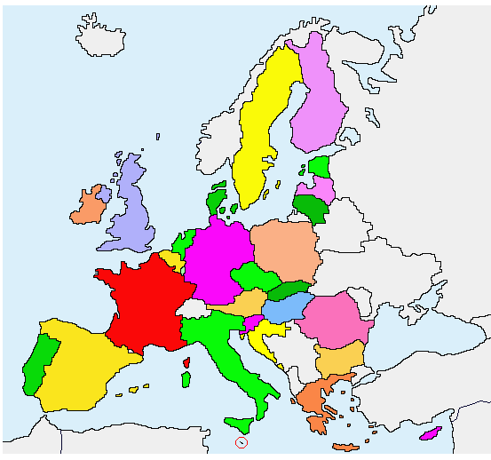
Mediterranean countries
France
Croatia
Spain
Portugal
Italy
Greece
Malta
Cyprus

Slide 2
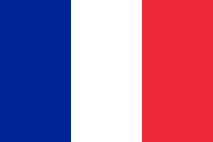
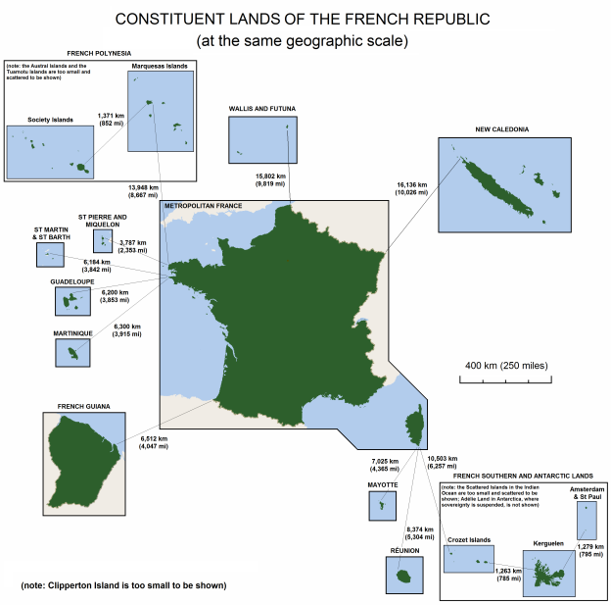
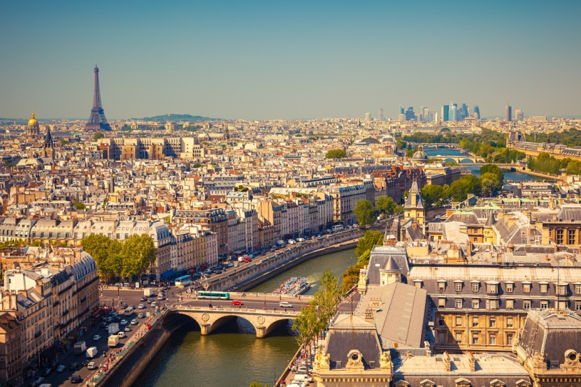
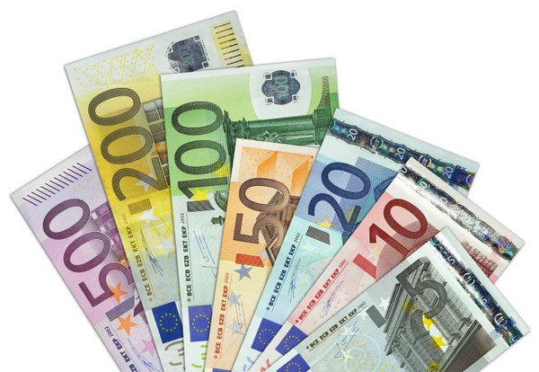
France
Geographical size: 632 833.6 km²
Capital: Paris
Currency: Eurozone member since 1 January 1999
Population: 66 million inhabitants
Population as % of total EU population: 13%
Official EU language: French

Slide 3
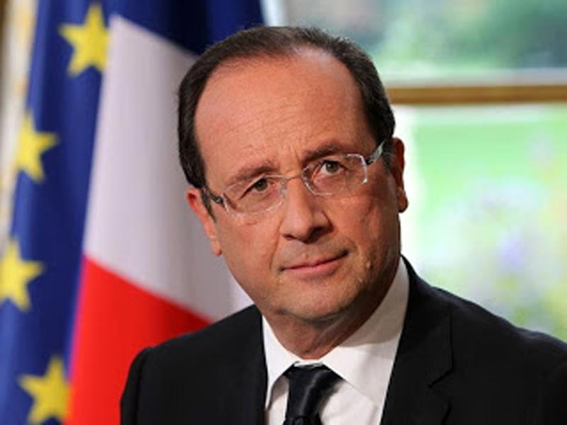
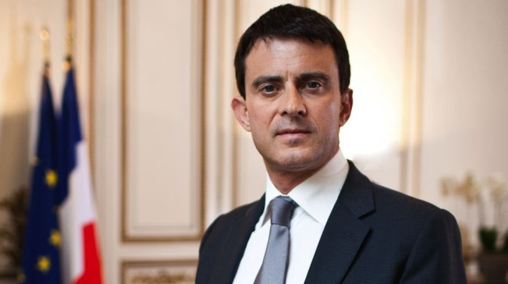
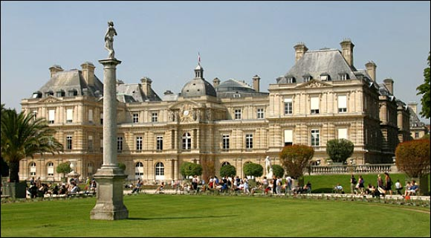
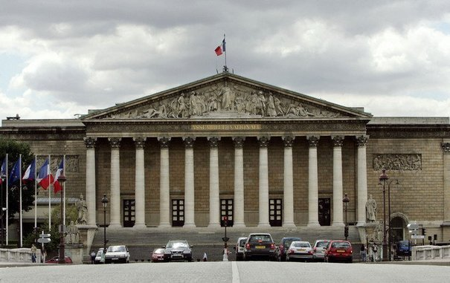
Political system: Semi-presidential republic
President: François Hollande
Prime minister: Manuel Valls
Legislature: Parliament
Upper house: Senate
Lower house: National Assembly

Slide 4
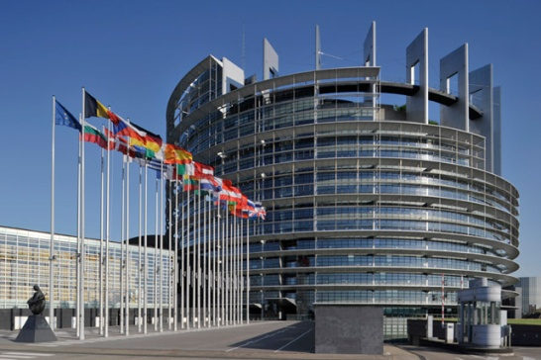
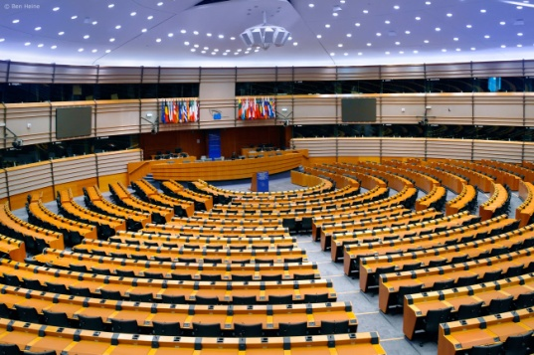
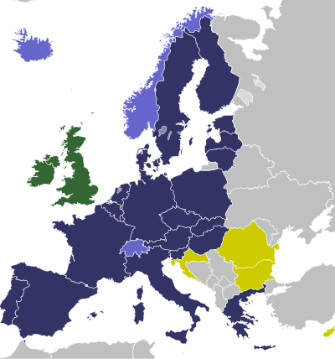

EU member country since: 1 January 1958
Seats in the European Parliament: 74
Schengen area member? Yes, Schengen Area member since 26 March 1995.
Presidency of the Council: France has held the revolving presidency of the Council of the EU 12 times between 1959 and 2008.

Slide 5

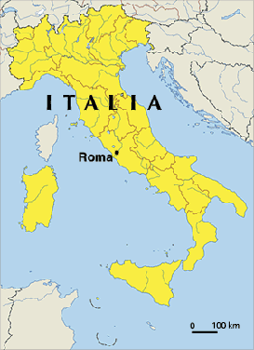
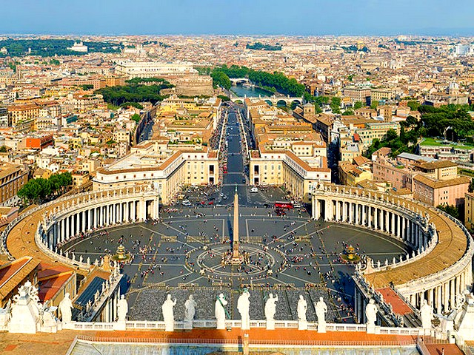
Italy
Geographical size: 301 336 km²
Capital: Rome
Currency: Eurozone member since 1 January 1999
Population: 60 million inhabitants
Population as % of total EU population: 12 %
Official EU language: Italian

Slide 6
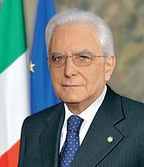
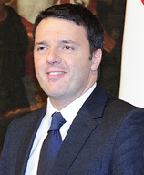
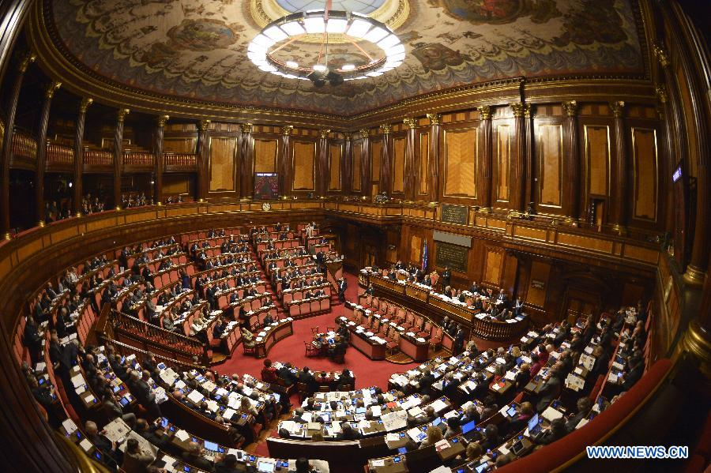
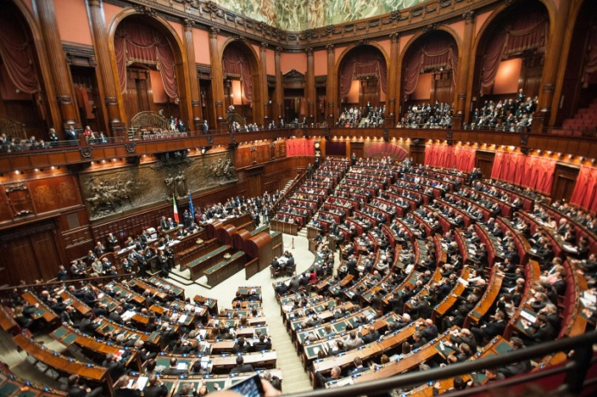
Political system: parliamentary republic
President: Sergio Mattarella
Prime minister: Matteo Renzi
Legislature: Parliament
Upper house: Parliament Senate
Lower house: Chamber of deputies

Slide 7
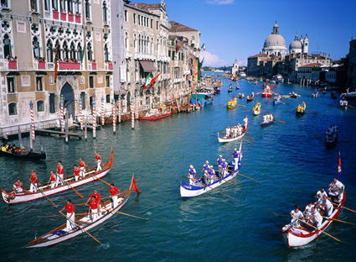
EU member state since: 1 January 1958
Seats in the European Parliament: 73
Schengen area member? Yes, Schengen Area member since 26 October 1997.
Presidency of the Council: Italy has held the revolving presidency of the council of the EU 12 times between 1959 and 2014.

Slide 8

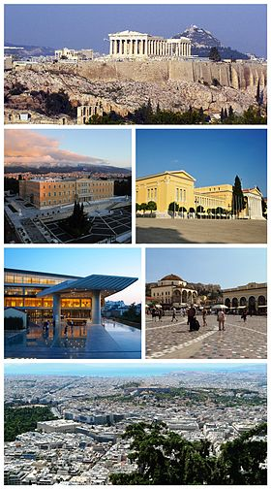
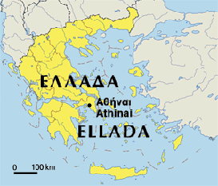
Greece
Capital: Athens
Geographical size:132 000 km²
Currency: Eurozone member since 1 January 2001
Inhabitants : 11, 120 million of inhabitants
Population as % of total EU population: 2.2 %
Official EU language : Greek

Slide 9

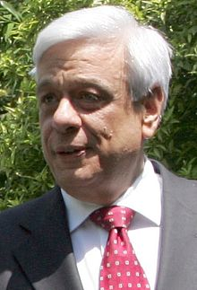
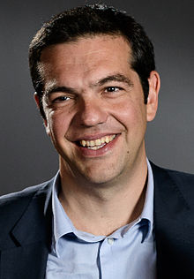
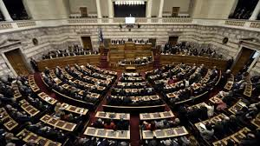
Political system: parliamentary republic
President : Prokopis Pavlopoulos
Prime minister : Alexis Tsipras
Legislature: Parliament

Slide 10
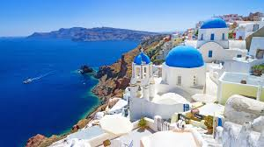
EU member country since: 1 January 1981
Seats in the European Parliament: 21
Schengen area member? Yes, Schengen Area member since 1 January 2000.
Presidency of the Council: Greece has held the revolving presidency of the Council of the EU 5 times between 1983 and 2014.

Slide 11

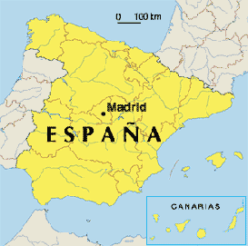
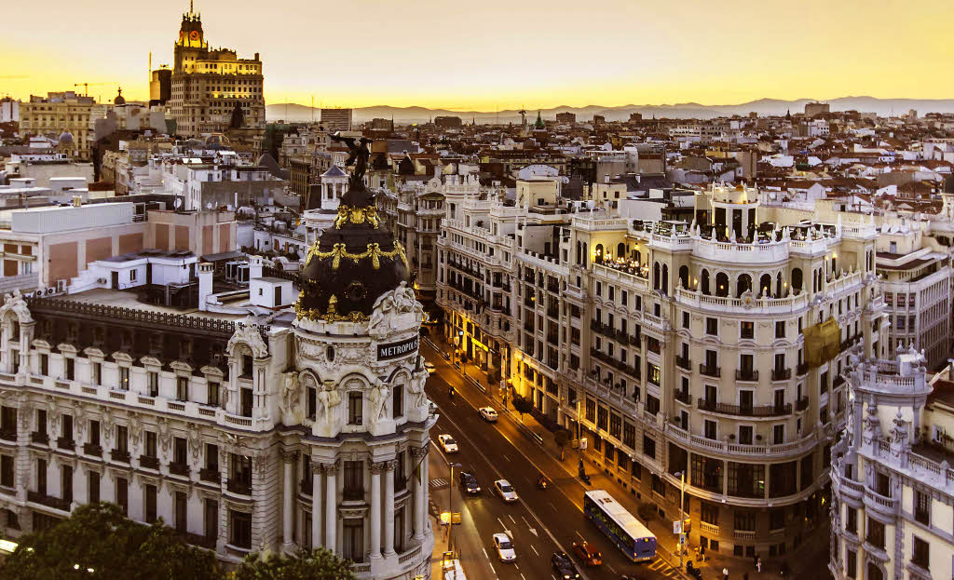
Spain
Geographical size: 505 990.7 km²
Capital: Madrid
Currency: Eurozone member since 1 January 1999
Population: 46 million
Population as % of total EU population: 9.2 %
Official EU language: Spanish

Slide 12
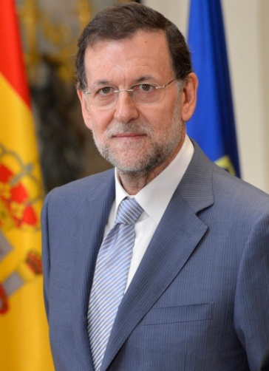
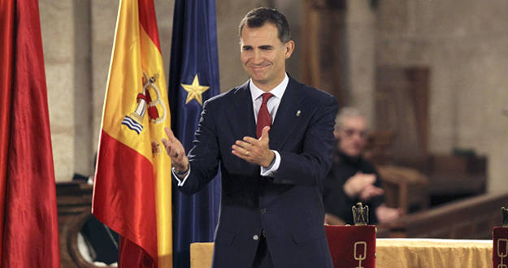
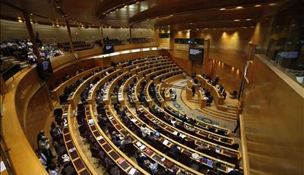
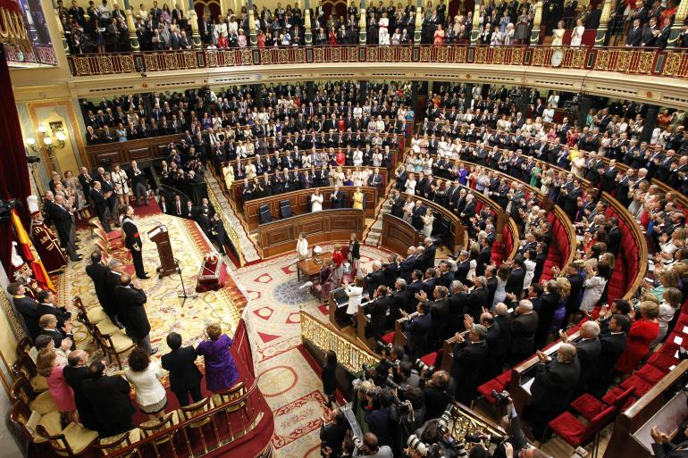
Political system: parliamentary constitutional monarchy
Monarch: Felipe VI
Prime minister: Mariano Rajoy
Legislature: General Courts
Upper house: Senate
Lower house: Congress of Deputies

Slide 13
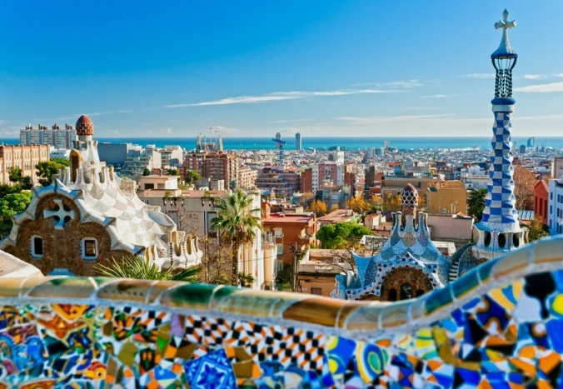
EU member country since: 1 January 1986
Seats in the European Parliament: 54
Schengen area member? Yes, Schengen Area member since 26 March 1995.
Presidency of the Council: Spain has held the revolving presidency of the Council of the EU 4 times between 1989 and 2010.

Slide 14

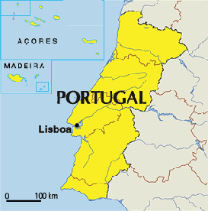
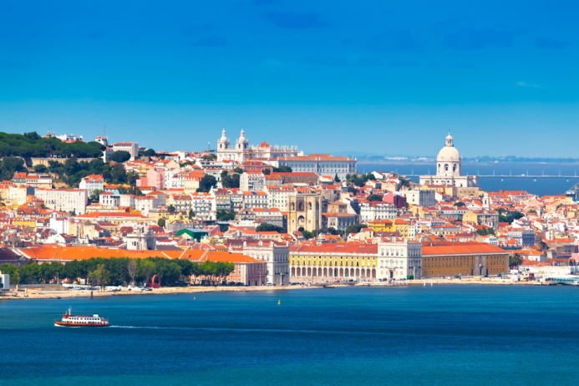
Portugal
Geographical size: 92 211.9 km²
Capital: Lisbon
Currency: Eurozone member since 1 January 1999
Population: 10 million
Population as % of total EU population: 2.1 %
Official EU language: Portuguese

Slide 15
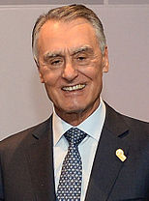
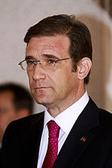
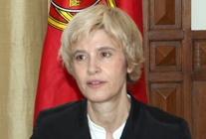
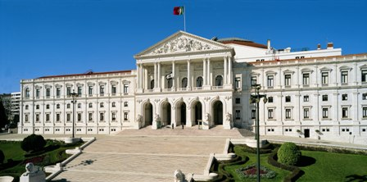
Political system: semi-presidential republic
President: Anibal Cavaco Silva
Prime Minister: Pedro Passos Coelho
Assembly President: Maria de Assuncao esteves

Slide 16
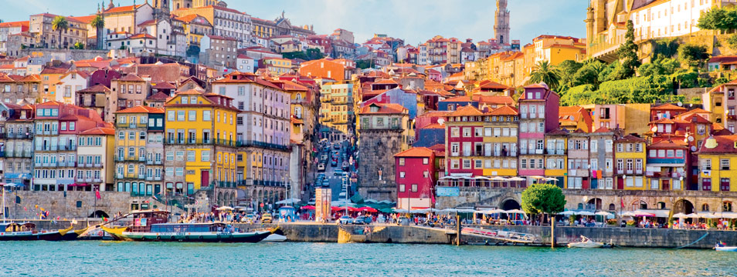
EU member country since: 1 January 1986
Seats in the European Parliament: 21
Schengen area member? Yes, Schengen Area member since 26 March 1995.
Presidency of the Council: Portugal has held the revolving presidency of the Council of the 3 times between 1992 and 2007.

Slide 17

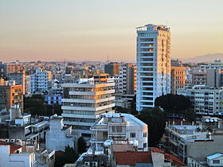
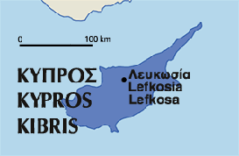
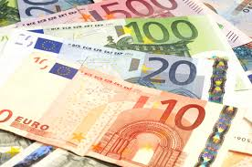
Cyprus
Capital: Nicosie
Geographical size: 9 251km²
Currency: Eurozone member since 1 January 2008
Inhabitants : 0,759 million of inhabitants
Population as % of total EU population: 0.2 %
Official languages : Greek and turkish

Slide 18
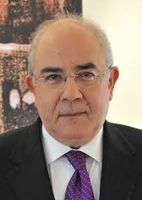
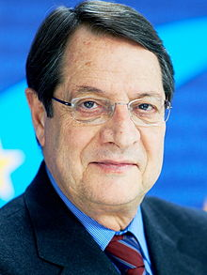
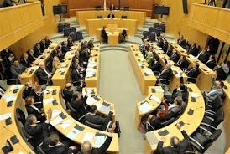
Political system: presidential republic
Legislature: House of Representatives
Président: Nikos Anastasiadis
Parliament of Cyprus: Yiannakis Omirou

Slide 19
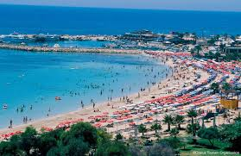
EU member country since: 1 May 2004
Seats in the European Parliament: 6
Schengen area member? No, Cyprus is not a member of the Schengen Area.
Presidency of the Council: Cyprus has held the revolving presidency of the Council of the EU once, in 2012.

Slide 20

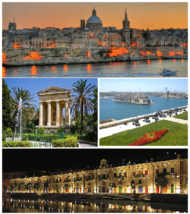
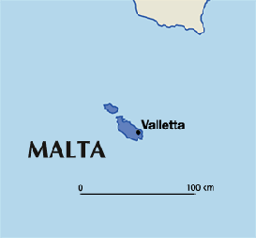
Malta
Capital: Valletta
Geographical size: 316 km2
Inhabitants: 0,403 million of inhabitants
Currency: Eurozone member since 1 January 2008
Population as % of total EU population: 0.1 %
Official EU languages : Maltese and English

Slide 21

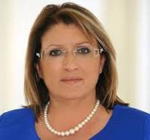
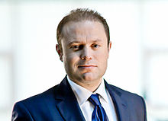


Political system: parliamentary republic
President: Marie Lousie Coleiro Preca
Prime minister: Joseph Muscat
Legislature: House of Representatives

Slide 22

EU member country since: 1 May 2004
Seats in the European Parliament: 6
Schengen area member? Yes, Schengen Area member since 21 December 2007.
Presidency of the Council: Malta will hold the revolving presidency of the Council of the EU for the first time in 2017.

Slide 23




Croatia
Capital: Zagreb
Geographical size: 56 642km2
Inhabitants : 4,285 million of inhabitants
Population as % of total EU population: 0.8 %
Currency: Croatian Kuna HRK
Official EU language : Croatian is the official language of Croatia, and became te 24th official language of the European Union upon tis accession in 2013.

Slide 24





Political system: parliamentary republic
President: Kolinda Grabar-Kitarovic
Prime Minister: Zoran Milanovic
Legislature: Sabor

Slide 25

EU member country since: 1 July 2013
Seats in the European Parliament: 11
Schengen area member? No, Croatia is not a member of the Schengen Area.
Presidency of the Council: Croatia has so far not held the revolving presidency of the Council of the EU.

