Slide 1
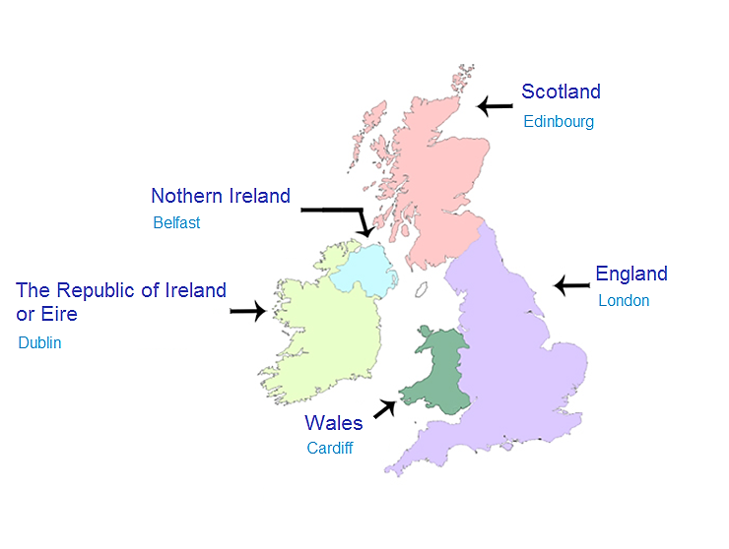
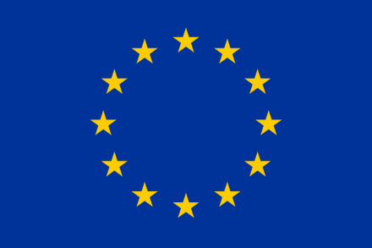
ANGLO-SAXON COUNTRIES

Slide 2
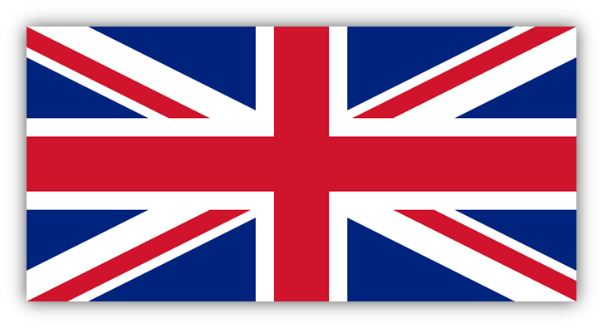
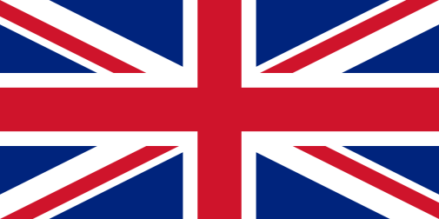
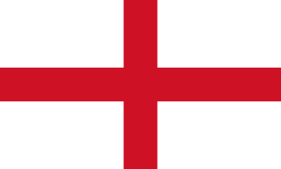
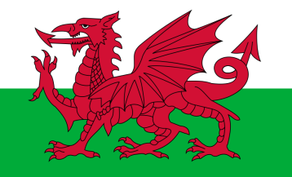
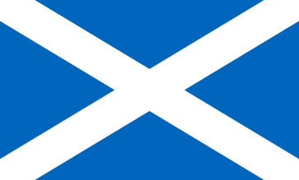
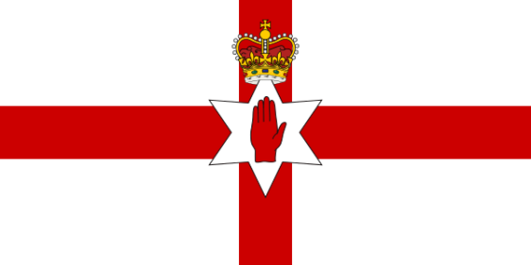
United Kingdom
73 seats in the European Parliament
Great Britain :
England Wales Scotland
Northern Ireland

Slide 3
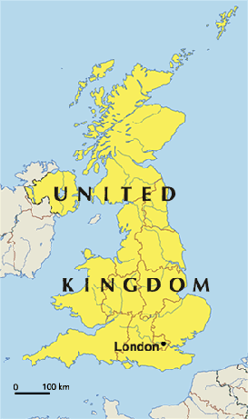
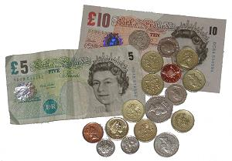
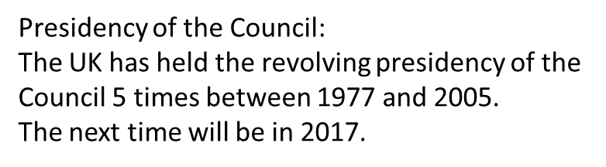
EU member country since 1973
Geographical size: 248 527.8 km²
64.3 milion of inhabitants
Population of total EU population: 12.7 %
Currency : pound sterling £
(not a Schengen area member)

Slide 4
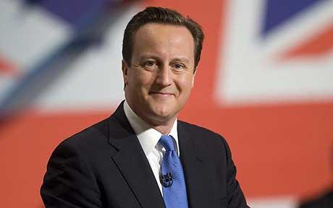
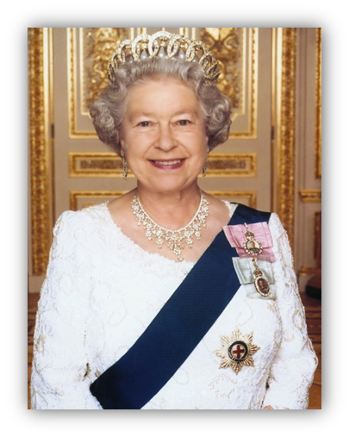
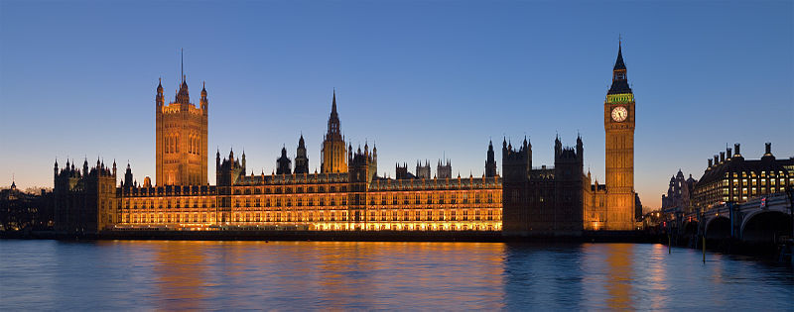
Political system: parliamentary constitutional monarchy
Monarch : Prime Minister : Elizabeth II David Cameron
The Palace of Westminster, seat of the Parliament

Slide 5
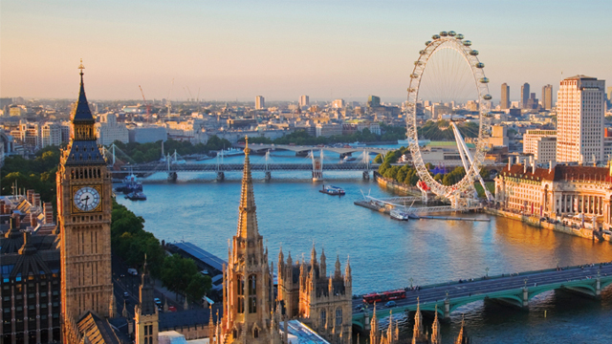
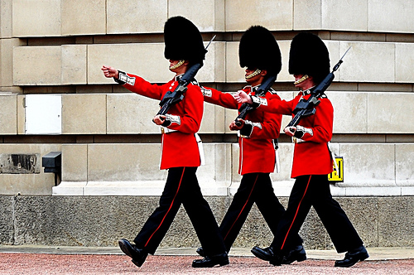
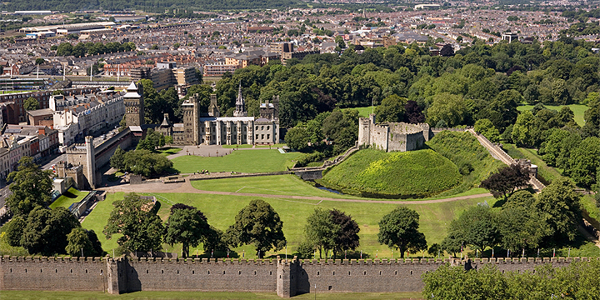
London (England)
Cardiff (Wales)

Slide 6
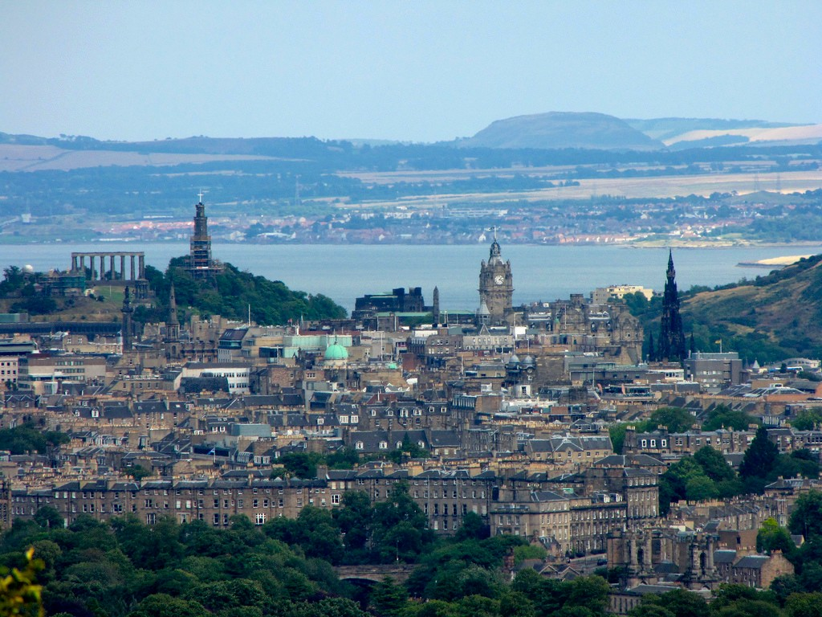
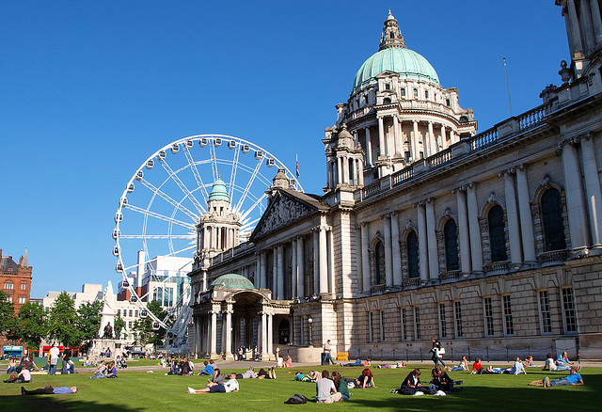
Edinbourg (Scotland)
Belfast
(Northern Ireland)

Slide 7
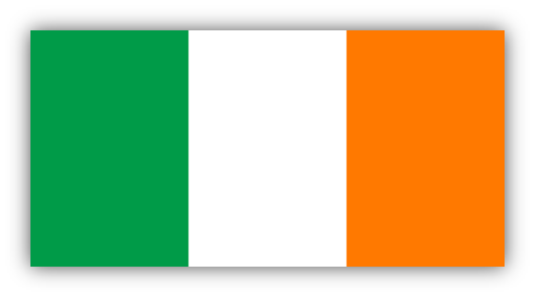
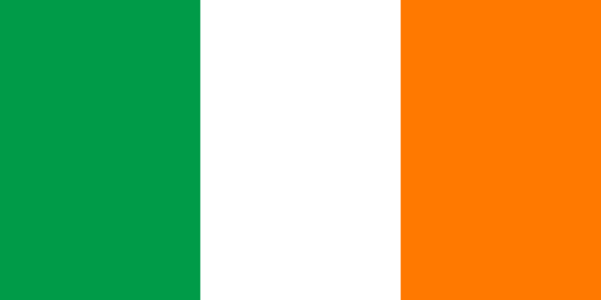
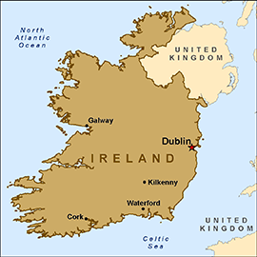
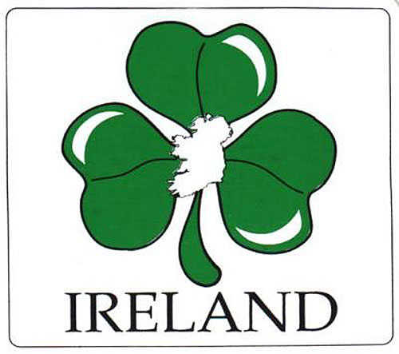
Ireland
11 seats in the European Parliament

Slide 8
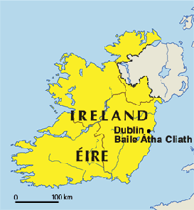
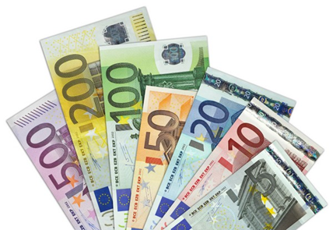
EU member country since 1973
Geographical size: 69 797 km2
Official languages: Irish, English
4.6 milions of inhabitants
Population of total EU population: 0.9 %
Currency : Euro ( But not a Schengen area member)
Presidency of the Council: Ireland has held the revolving presidency of the Council of the EU 7 times between 1975 and 2013.

Slide 9
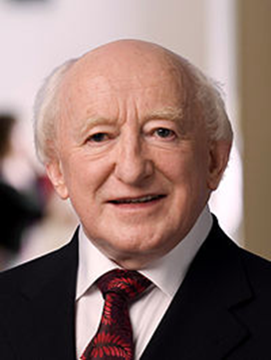
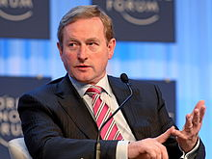
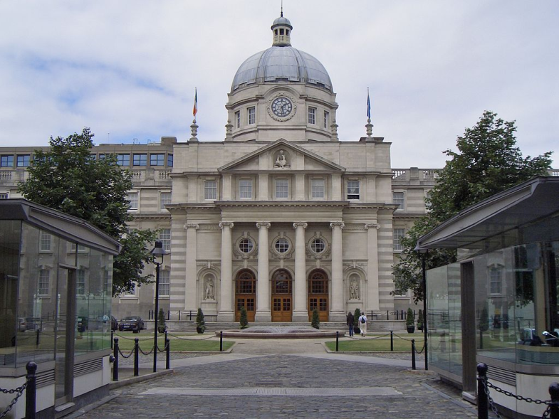
Political system: parliamentary republic
President: Prime Minister Michael D. Higgins Enda Kenny
Government Building

Slide 10
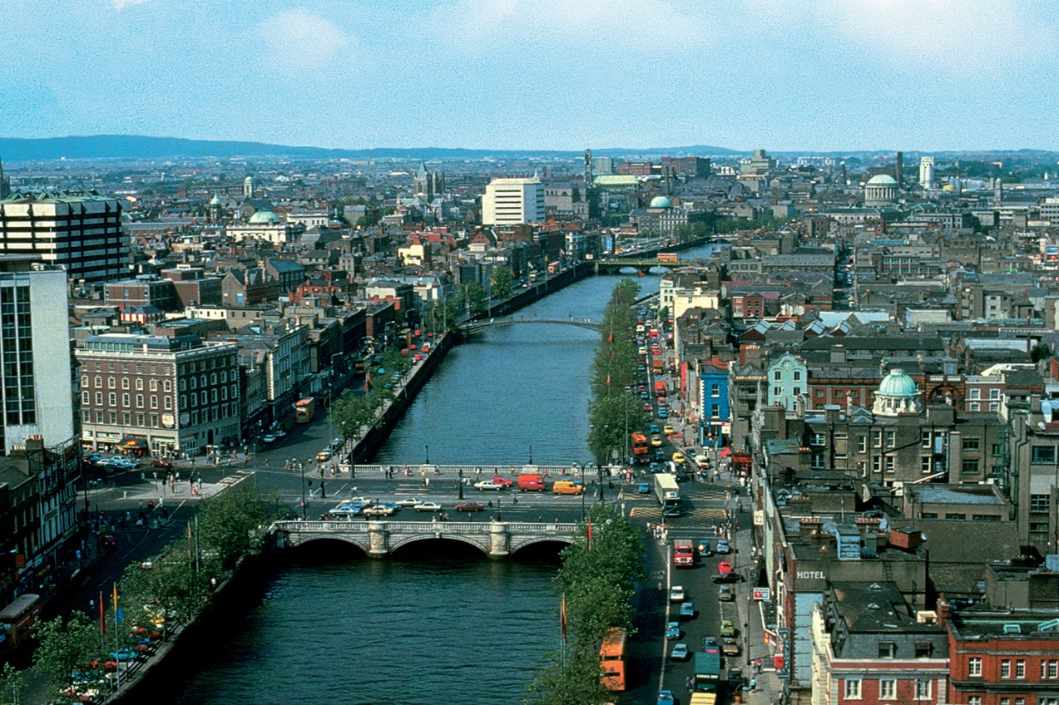
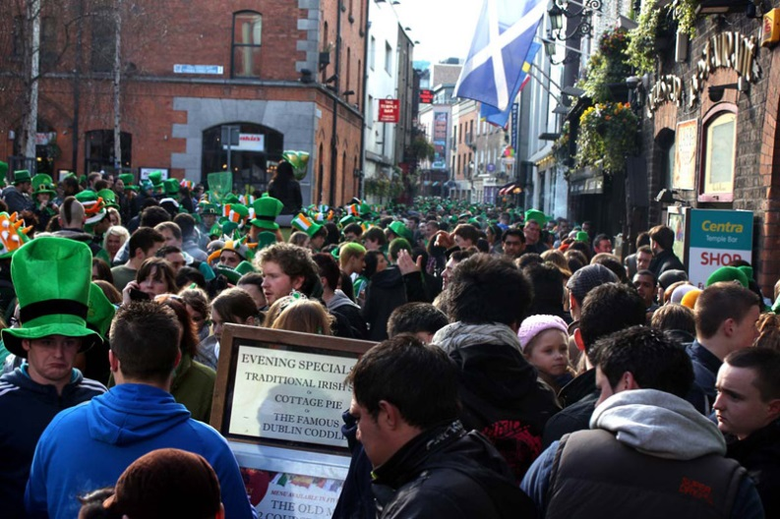
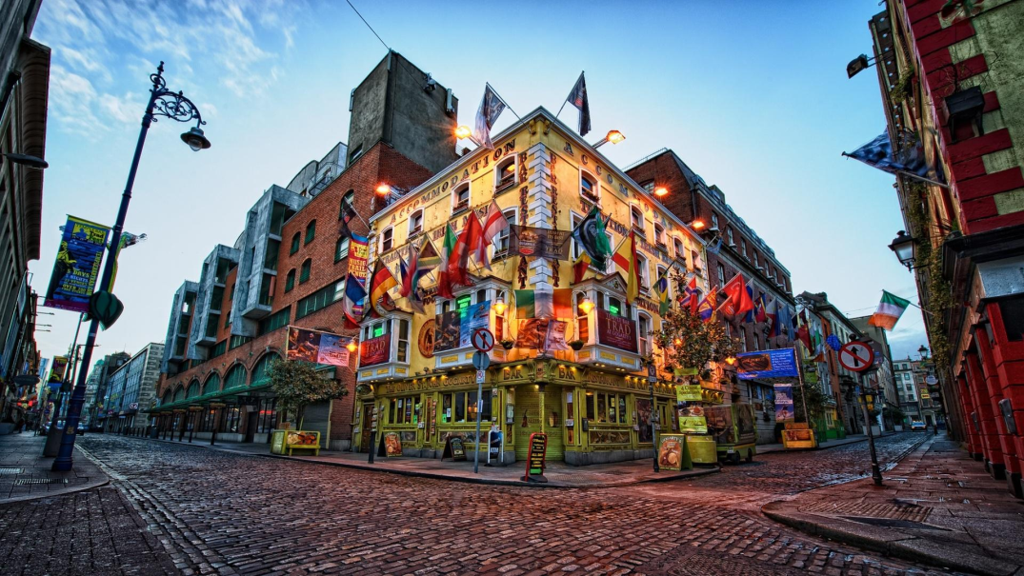
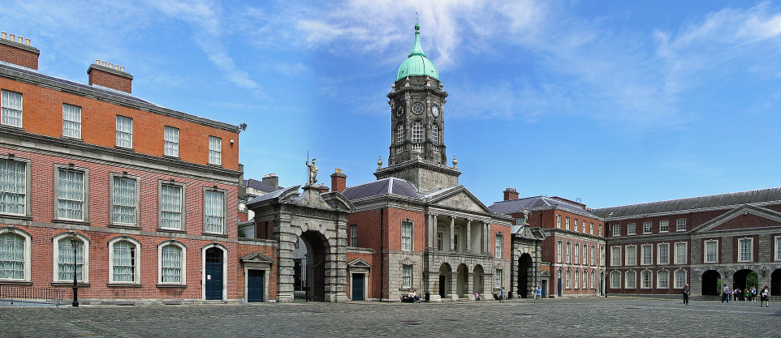
Dublin

